Slide 1

RGB-D Tracking
By Wenzhang Qian
April 27, 2018

Slide 2
Table of Content
Intro to my project
KCF/DS-KCF tracker research
KCF tracker introduction
Improvements based on KCF tracker
The principles of DS-KCF tracker
My Results

Slide 3
RGB-D Tracking
Input: RGB(width x height x 3) + Depth (width x height x 1)
Objective: Make use of the depth information for higher accuracy. The speed certainly will decrease because of one more channel.

Slide 4
Advantage from depth
When the target rotates, deforms or is under occlusion.
Target appearance can change significantly after rotation or deformation, making recognition difficult, which are the main causes of model drifting for traditional RGB tracker.
The depth or 3D features are still distinguishable when the similarity in RGB vanishes.
[Song, S., Xiao, J. Tracking Revisited using RGBD Camera: Baseline and Benchmark(2012). https://arxiv.org/abs/1212.2823]

Slide 5
2.1 KCF tracker introduction
Kernelized Correlation Filter(KCF) is a accurate and fast general –purpose tracker
Personally, it is my favorite. It is used as the default tracker in my robotic projects.

Slide 6
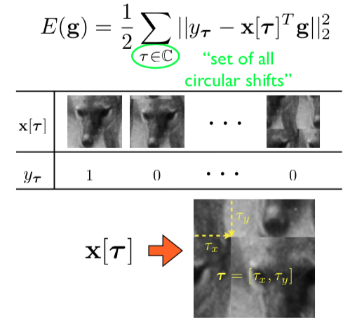
Math

Slide 7
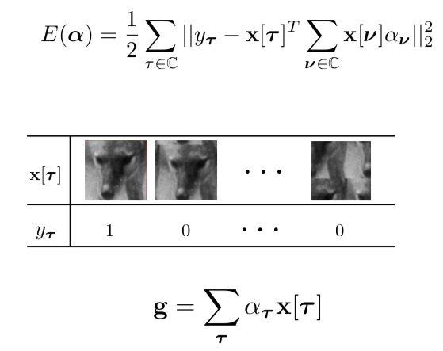

Slide 8
Quotes from Hawking
Someone told me that each equation I included in the book would halve the sales.
- Stephen Hawking

Slide 9
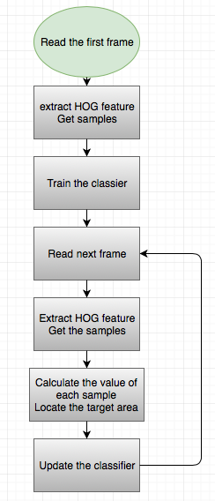

Slide 10
HOG features
Histogram of Oriented Gradient
It is a common feature to describe images.
The author of KCF uses FHOG feature.
Gradient
Gradient in X, Y direction
Gx = I(x+1, y) – I(x-1, y), Gy = I(x, y+1) – I(x, y-1)
Gradient in magnitude
G(x, y) = sqrt(Gx^2 + Gy^2)
Gradient in direction
Theta = arctan(Gy/Gx)

Slide 11
FHOG
Felzenszwalb's HOG (FHOG) features
A fast implementation of the HOG variant used by Felzenszwalb et al. in their work on discriminatively trained deformable part models. [http://www.cs.berkeley.edu/~rbg/latent/index.html] Gives nearly identical results to features.cc in code release version 5 but runs 4x faster (over 125 fps on VGA color images).

Slide 12
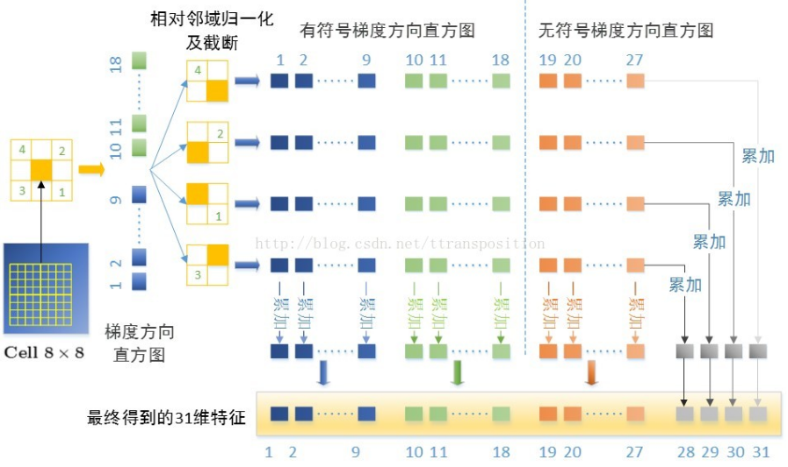
FHOG feature
The result of FHOG feature extraction is a matrix of size of W*h*31.
W = Width / cell size(4 in KCF)
H = Height / cell size(4 in KCF)

Slide 13
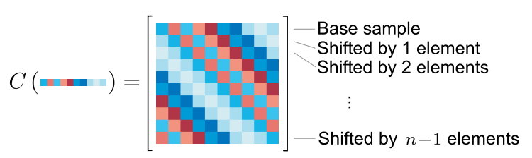
Circulant Toeplitz Matrices
By circulant displacement, a lot of samples are obtained.
Dense sampling (just like sliding windows)
No missing samples in random sampling
Faster than sliding windows (MANY MANY Fourier Transformations)

Slide 14
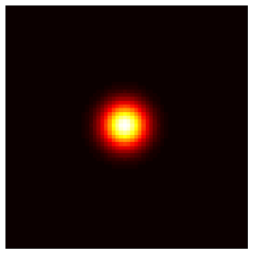
Classifier
Sample set ---- xi
From circulate displacements
Label set ---- yi
Gaussian shape (high in the center)
Classifier --- f()

Slide 15
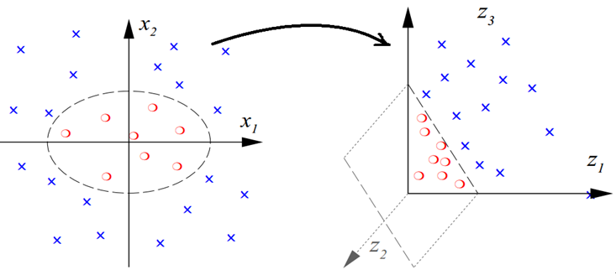
Gaussian Projection
We are dealing with problems cannot be separated linearly in 2 dimension.
Points cannot be separated linearly in 2D can be projected to higher dimension, where they can be separated linearly.
Gaussian Kernal is used

Slide 16
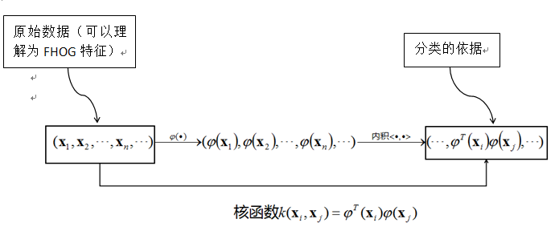
Gaussian Kernel Extension
It is difficult to find the explicit expression of this projection in most cases. However, inner product of datapoints (in higher dimension) can be used for classification
Raw Data(FHOG)
For classification

Slide 17
2.2 Improvements based on KCF tracker
Parameter tuning for my dataset
Combination of parameters
Performance measurements

Slide 18
Tunable parameters in KCF
parameters | Padding (search area) | Interploation-factor | Lambda (prevent overfitting)
function | Provide the search region | Decide the refresh speed of the classifier | Prevent overfitting of the classifier
how | Higher the padding, better the resistance for fast moving objects | Higher the factor, better for fast motion at the cost of stability | Too small → over fitting Too larger → under fitting

Slide 19
Performance measurements
FPS > Location difference > Scaling difference

Slide 20
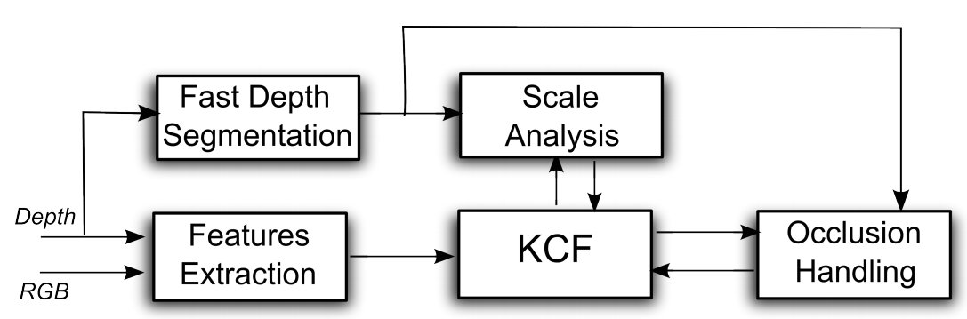
2.3 The principle of DS-KCF
Integrating depth information to better deal with scale difference and occlusion.

Slide 21
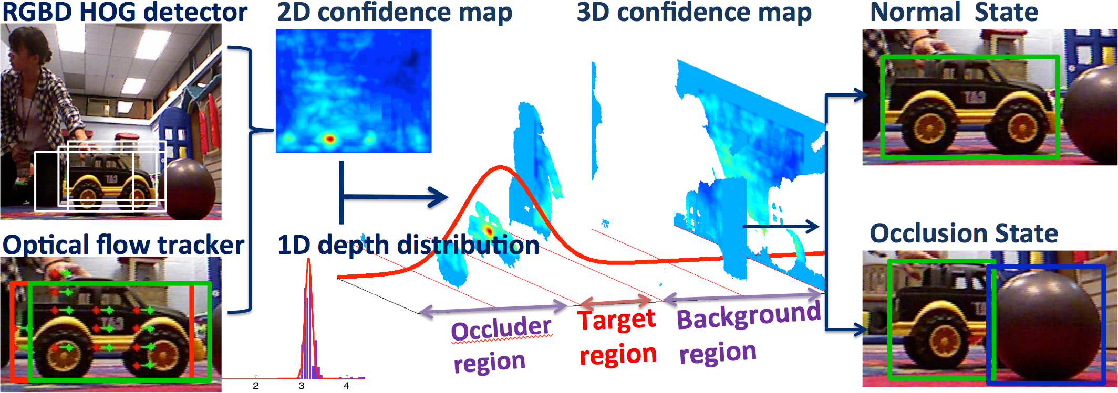
2.3 The principle of DS-KCF
Fast Depth Segmentation
Calculate the stats of depth information
Detecting and handling scale changes
Using depth information to calculate the scaling in the bounding box
Detecting and handling occlusions
Using depth information to detect occlusion and recover from it.

Slide 22
Fast Depth Segmentation
Two steps for depth segmentation
K-mean algorithm to evaluate the initial cluster or ROI
In HOG, every local maximum is used as the initial cluster center.
Every datapoint is distributed to its closest cluster
Keep updating the centers until convergence
Accurately determine the ROI by analyzing the feature of neighboring region
Separate different region with same depth and remove region with small area.

Slide 23


Detecting and Handing Scale Changes
There are two types of scaling factor used in DS-KCF
Continuous scaling factor
Measurement scaling factor
In the end, choose the factor in Sq closest to Sr

Slide 24
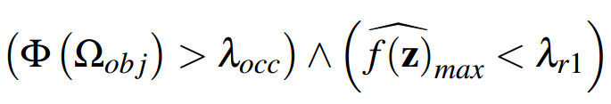
Detecting and handling occlusions
Assumption: the depth distribution in the bounding box is a Gaussian distribution
Fast Depth Segmentation can separate the target from the occlusion
The condition of occlusion
In my implementation, I use 35% and 0.4

Slide 25

Detecting and handling occlusions
When the condition is true, the occlusion object is tracked
During occlusion, the search region is
Occlusion region in the last frame + best candidate region before occlusion + Occlusion region in the current grame

Slide 26

Detecting and handing occlusions
Recover condition
In my implementation, 35% and 0.2 is used

Slide 27
My Development Environment
Development environment:
Unbuntu 14.04
Dependencies:
OpenCV2

Slide 28
My Implementation of KCF
Tracking starts when the target is 1.5 m from the camera and the initial velocity is 0.4 m/s.
Velocity increases with distances
Maximum distance is 5m and the maximum velocity is 0.6 m/s.
Initial rotation speed is 0, which increases as the target drifts away from the center of the camera.
Maximum rotation speed 0.75 rad/s.
All the parameters can be modified in src/main.cpp

Slide 29
My implementation of DS-KCF
Fast Depth Segmentation
Calculate the stats of depth information
Kcftracker.cpp – getDepth()
Detecting and handling scale changes
Using depth information to calculate the scaling in the bounding box
Scale = target depth in the last frame / target depth in the current frame
Kcftracker.cpp – update()
Detecting and handling occlusions
Using depth information to detect occlusion and recover from it.
TO BE IMPROVED. Current condition does not work at all.

Slide 30
DEMO

Slide 31
Obvious Problems
Occlusion handling completely failed
Tracker suddenly starts tracking the background and fails
My parameters do not work for every scenario

Slide 32
Future Work
Better occlusion detection and recover conditions
Dive into the problem of background tracking
Adaptive parameters (Adaptive HOG is done)
Mutithread processing (TBB)

Slide 33
QUESTIONS?

